Slide 1
Class Ten
Smart Navigation

Slide 2
Overview
What's new?
Attendance
Quiz
Autopsy
The Chapter
Lab
Notes:
5 minutes

Slide 3
What’s New?
Safety net is off

Slide 4
Quiz Time
Notes:
10 minutes

Slide 5
Website Autopsy
http://www.timtebow.com/
http://www.converse.com/
http://rawkes.com/
http://two24studios.com/
http://blogs.adobe.com/conversations/2011/11/flash-focus.html
Notes:
20 - 30 minutes

Slide 6
Break
Notes:
Break – 8 minutes

Slide 7
The Chapter

Slide 8

Smart Navigation
Leads the way
Starts with IA
One of the most important parts of your website
Notes:
http://www.flickr.com/photos/chunter01/6331005348/sizes/l/in/photostream/

Slide 9
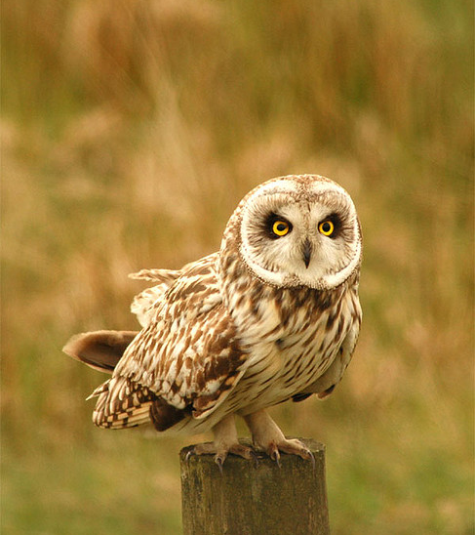
Navigation Names
A "really big deal"
Short – one, two words at most
Descriptive – clear and straight to the point
Notes:
http://www.flickr.com/photos/wildaboutburnley/329910656/sizes/z/in/photostream/

Slide 10
Semantic HTML
<ul id="navigation">
<li><a class="active" title="Home" href="/">Home</a></li>
<li><a title="My Blog" href="/blog/">Blog</a></li> <li><a title="My Portfolio" href="/portfolio/">Portfolio</a></li>
<li><a title="Contact us" href="/contact/">Contact</a></li>
</ul>

Slide 11

Horizontally-tabbed Navigation
http://myob.com.au/
http://www.blackbookmag.com/guides/chicago
http://www.veer.com/

Slide 12
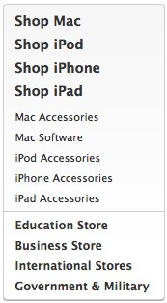
Vertical Navigation
http://store.apple.com/us
http://www.l-s.com/

Slide 13
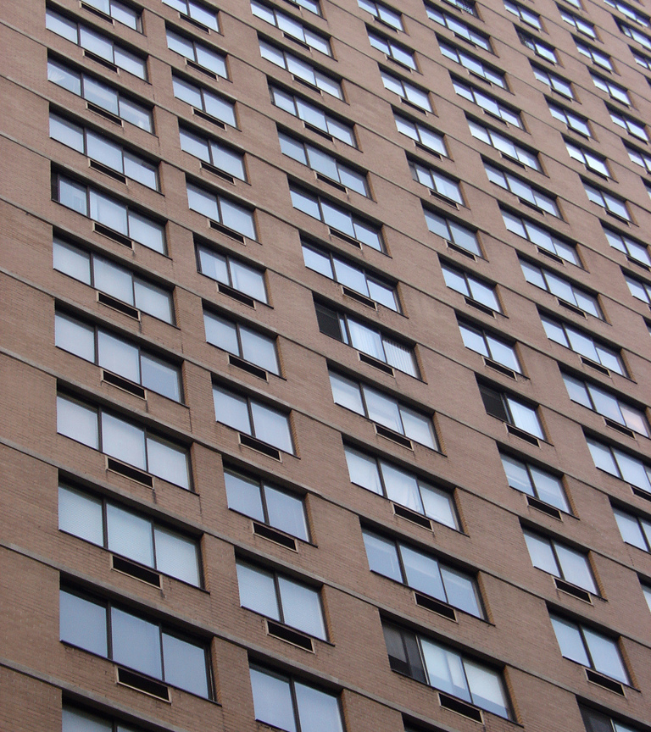
Consistency
Logical placement
Links look like links
Give 'em space
Notes:
http://www.flickr.com/photos/villes/2885282987/sizes/l/in/photostream/

Slide 14
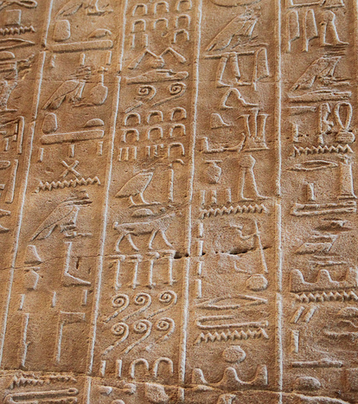
Icon Usage
Don't say anything
High potential for confusion
Add icons to text, not other way around
Notes:
http://www.flickr.com/photos/martie1swart/6191496007/sizes/z/in/photostream/

Slide 15
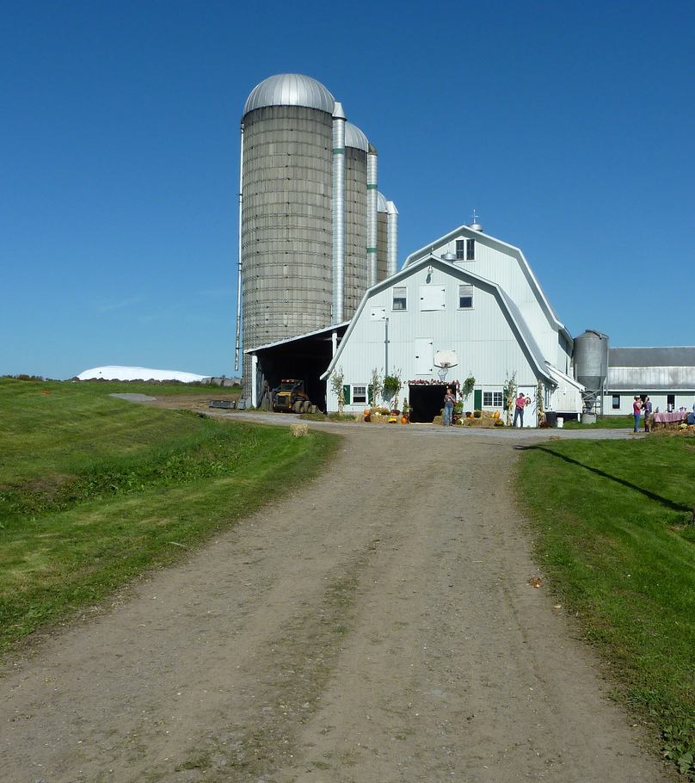
Secondary Navigation
Changes as users navigate
Applies to "current section" of site
Usually for child pages
Notes:
http://www.flickr.com/photos/mlukesh/6319891949/sizes/l/in/photostream/

Slide 16
Break
Notes:
Break – 8 minutes

Slide 17
Lab
Make the USF homepage:
http://dl.dropbox.com/u/41609448/art329/slides/classten/usiouxfallsedu.zip

Slide 18
Class Eleven
Writing for the Web

